Slide 1
CSI-based WiFi Sensing Course Project
Lila Rana
Broadband Digital Communication EESC 6353.001
¹ Zubow, Anatolij, Kim Petto, and Falko Dressler. “One-Class Support Vector Machine for WiFi-Based Device-Free Indoor Presence Detection,” European Wireless 2023; 28th European Wireless Conference

Slide 2
Outline
Introduction
Wi-Fi Sensing
RSSI vs CSI
Wi-Fi CSI
Methodology
Experiment Scenario
OC SVM and 1D CNN
Results
Conclusion

Slide 3
Introduction
The rapid development of wireless technologies has driven major progress in communication, networking, and sensing.
Radio Frequency (RF) systems leverage radio waves for both communication and sensing, enabling detection of human presence and movement through signal analysis.
Wi-Fi sensing has emerged as a promising technique that utilizes Wi-Fi signals to sense and interpret the environment.
Wi-Fi-based human sensing offers distinct advantages such as utilizing existing infrastructure and reducing deployment complexity and costs.
Notes:
The rapid evolution of wireless technologies has led to significant advancements in communication, networking, and sensing. Radio Frequency (RF) systems, which rely on radio waves for signal transmission and reception, have expanded beyond traditional communication to enable human sensing by capturing valuable information about the presence and movement of individuals. Among these, WiFi sensing has emerged as a promising approach that leverages existing WiFi signals to perceive and interpret the surrounding environment. This technology supports a wide range of applications, including indoor localization, human activity recognition (HAR), environmental monitoring, pose estimation, and gesture identification. WiFi-based human sensing offers distinct advantages such as utilizing pre-existing infrastructure, thereby reducing deployment complexity and costs. Furthermore, the use of high-frequency signals provides higher resolution data, enabling accurate and fine-grained tracking of human motion and environmental changes.

Slide 4
Wi-Fi Sensing
Detection-based sensing
Provides outputs in binary format.
Recognition-based sensing
Provides multiclass classification outputs.
Estimation-based sensing
Aim to calculate the quantity of different parameters, for example size, length, angle, distance, duration, etc.
Popular application: Human presence detection and human event detection.
Other examples: object detection and detecting LoS/NLoS signals, etc.
Popular application: Activity recognition, gesture recognition, and human/user identification.
Other examples: object recognition, object/event recognition, etc.
Popular application: Human/object localization and tracking.
Other examples: people counting, Wi-Fi imaging, etc.
Notes:
Wi-Fi sensing techniques can generally be categorized into three main types based on the nature of their output and applications.
Detection-based sensing:
"First, we have detection-based sensing, which provides simple binary outputs — typically indicating whether something is present or absent."
"A common example is human presence detection or event detection."
"It can also be used for tasks like object detection or distinguishing between LoS (Line-of-Sight) and NLoS (Non-Line-of-Sight) signal conditions."
Recognition-based sensing:
"Next, recognition-based sensing performs multiclass classification — meaning it can recognize and categorize multiple types of events or activities."
"This is popular for activity recognition, gesture recognition, and human or user identification."
"It also extends to tasks like object recognition and event recognition where more complex outputs are required."
Estimation-based sensing:
"Finally, we have estimation-based sensing, which focuses on estimating quantitative parameters such as size, distance, angle, and duration."
"Key applications include localization and tracking of humans or objects."
"It’s also used in people counting and more advanced techniques like Wi-Fi imaging.
Each of these sensing types plays a vital role depending on whether we want to detect, recognize, or estimate characteristics of the environment or the people within it.

Slide 5
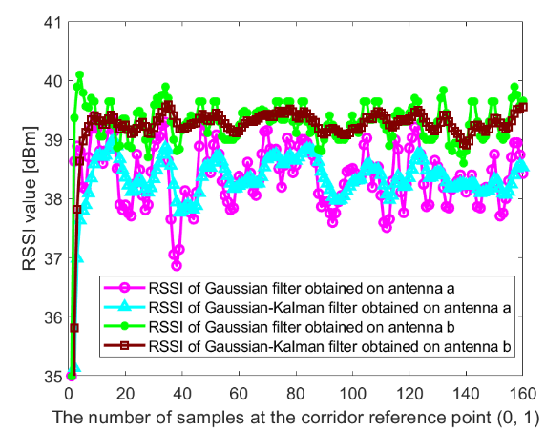
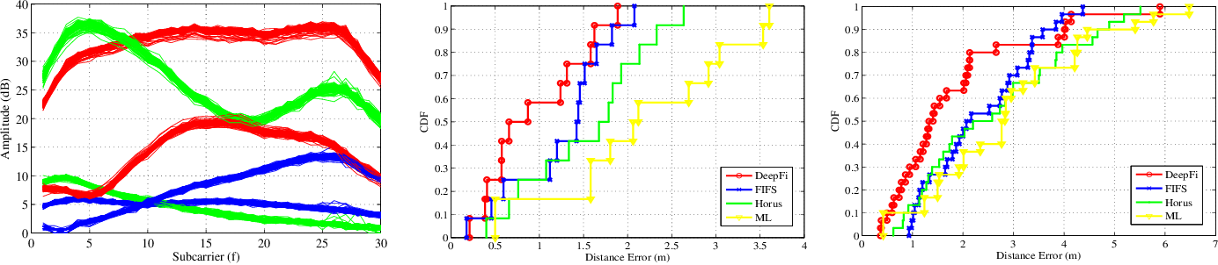
RSSI vs CSI
RSSI
CSI
Suffers from temporal fluctuations in multipath environments, which makes RSSI a coarse-grained feature.
RSSI not only varies over distance on the order of the wavelength of the wireless signal but also wavers over time even at a fixed distance.
Due to slight changes in the environment, fluctuations in multipath components may cause the phase of the reflected signals to add up constructively or destructively, resulting in considerable change in RSSI.
CSI features, such as Channel Impulse Response (CIR) and Channel Frequency Response (CFR), capture multipath effects and are robust against environmental changes
CIR is the temporal linear filter used to model a wireless channel to capture the multipath profile, whereas, in the frequency domain, CFR characterizes frequency-selective fading caused by the constructive and destructive phases of the multipath.
These channel responses provide finer-grained measurements (higher frequency and time resolutions) than RSSI and can discriminate fast-changing multipath phases.
CSI sequences for 2 Tx & 3 Rx
Notes:
RSSI (Received Signal Strength Indicator):
A measure of the power level of a received wireless signal, indicating how strong the signal is at the receiver.
CSI (Channel State Information):
Detailed information describing how a wireless signal propagates from the transmitter to the receiver, including the effects of fading, scattering, and multipath across different subcarriers and antennas.
A radio signal propagating through the wireless channel to the receiver through multiple paths experiences several effects. Reflection on walls or scattering through obstacles will produce additional copies of the transmitted signal, socalled multipath components. These different components of the signal correspond to pulses at the receiver at different arrival times. The Channel Impulse Response (CIR) is used to describe these impulses

Slide 6
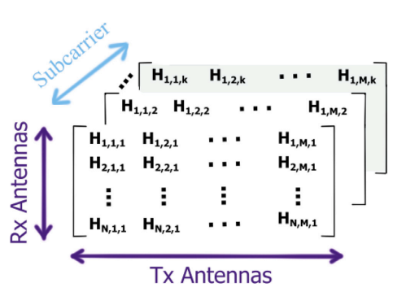
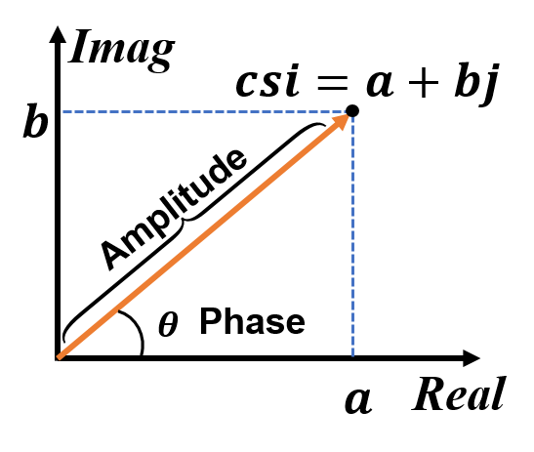
Wi-Fi CSI
h₁₁
x₁
h₂₁
y₁
Transmitter
Antenna
h₁₂
h_{1N}
y₂
Receiver
Antenna
x₂
h₂₂
..
h_{N1}
..
x_{M}
h_{N2}
y_{N}
h_{NM}
Multiple Input Multiple Output (MIMO) at any time instant can modeled as
y_{i} = H_{i}x_{i} + n_{i} for for i ∈ {1, . . ., k} where k is the number of OFDM subcarriers
x_{i} and y_{i} are transmitted and received signal vector for the i-th subcarrier
H_{i} is the channel matrix for i-th subcarrier
CSI describes how a signal propagates from Tx to the Rx
H = H1, H2, H3….appears in a complex form a+bi.
|√a2+b2| - Amplitude 𝜃=𝑎𝑟𝑔𝑡𝑎𝑛(𝑏/𝑎)- Phase
Notes:
Let’s begin by understanding the basic MIMO model for OFDM systems.”
“At any given time instant, the received signal yi at subcarrier i can be modeled as yi = Hixi + ni.”
“Here, xi is the transmitted signal vector, yi is the received signal vector, and ni is the noise vector.”
“The matrix Hi represents the channel effects — this is the channel matrix for the i-th subcarrier.”
“This equation holds for i ranging from 1 to k, where k is the number of OFDM subcarriers.”
The set of channel matrices across all subcarriers, H = {H1, H2, H3, …}, is what we call the Channel State Information (CSI).”
“CSI provides a detailed description of how the transmitted signals propagate from the transmitter (Tx) to the receiver (Rx).”
“It captures the effects of multipath fading, reflection, diffraction, and scattering.”
Each element of H is complex-valued, usually represented as a + bi.”
“From this, we can derive two important properties:”
“|√(a² + b²)| — this is the amplitude of the channel response.”
“𝜃 = arctan(b / a) — this gives the phase.”
“Both amplitude and phase are essential for understanding the wireless channel’s behavior and for tasks like beamforming, equalization, and sensing.”

Slide 7
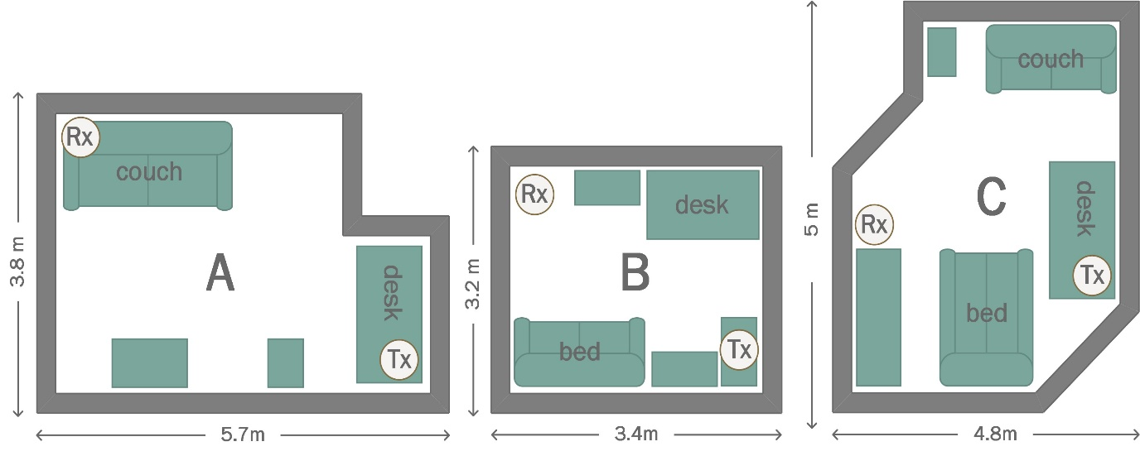
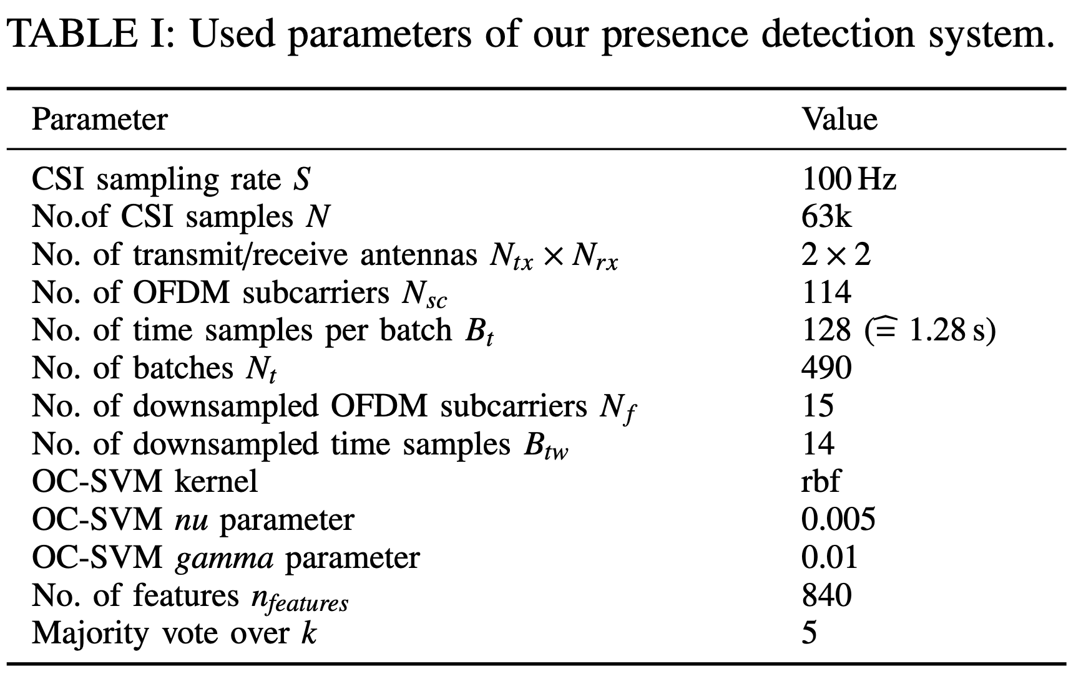
Experiment Scenario
Three rooms A, B and C
Sampling rate of 100 Hz
Empty Room : Human Free
Occupied Room: Human was walking, standing, and sitting, where applicable, randomly inside the room
Channel BW- 40 MHz
2.4GHz on channel 1 and 5 GHz on Channel 36
Intel 9260- IEEE 802.11ac
2x2 MIMO
Notes:
The experiments were performed within three different apartment rooms. The location of the two WiFi nodes as well as furniture is shown in Fig. 2. The transmitter and receiver inside the rooms a and c didn’t have LOS due to the different heights and position atop of the desk.
In order to collect CSI data we transmitted unicast data packets with a transmission rate of 100 Hz using BPSK modulation with a coding rate (FEC) of 1/2 and channel bandwidth of 40 MHz. The experiment was performed in 2.4 GHz band on channels 1 and 5 GHz band on channel 36.
Finally, they collected CSI under two scenarios: i) empty (human-free) room and ii) human-present-occupied room. For the latter scenario the human was walking, standing, and sitting, where applicable, randomly inside the room. The person alternates between the above-described actions and performs each action for an unspecified time duration. The collected CSI datasets were labeled accordingly. Each collection session lasts for about 10.5 min, resulting in 63k CSI samples.

Slide 8
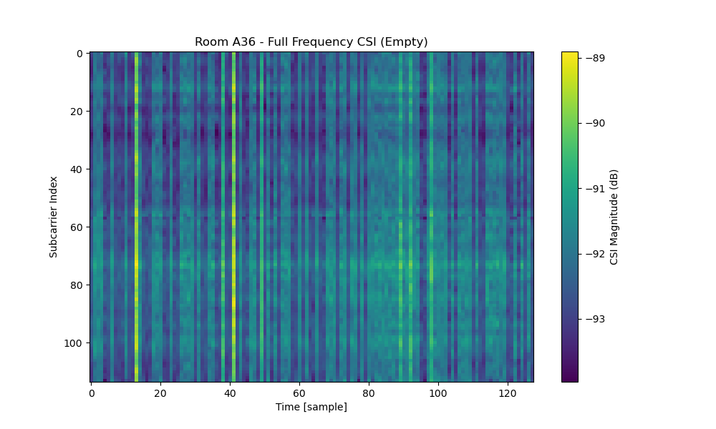
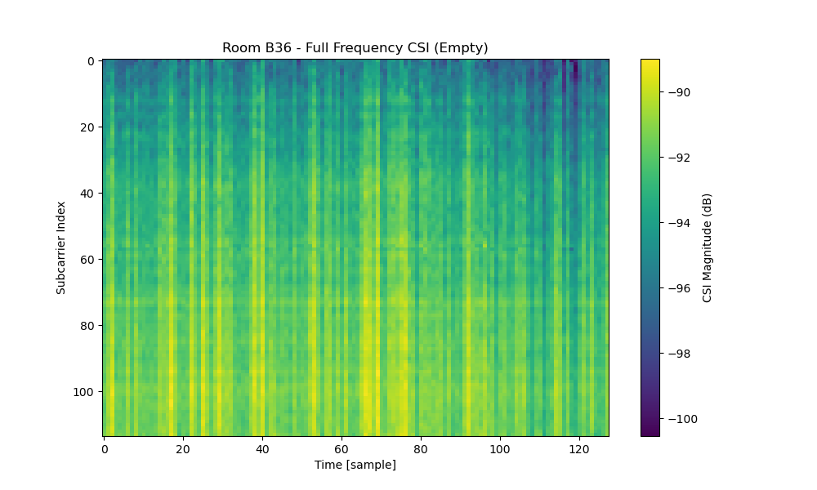
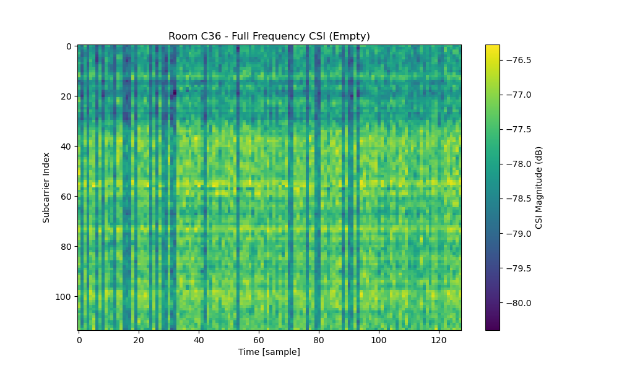
Wi-Fi CSI
Distinct patterns due to unique propagation profile of each room.
Empty Room A
Empty Room B
Empty Room C

Slide 9
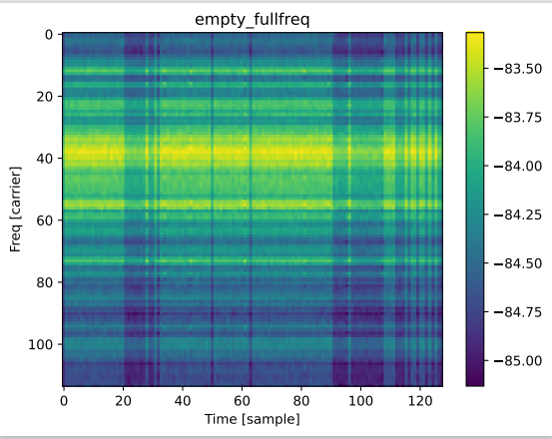
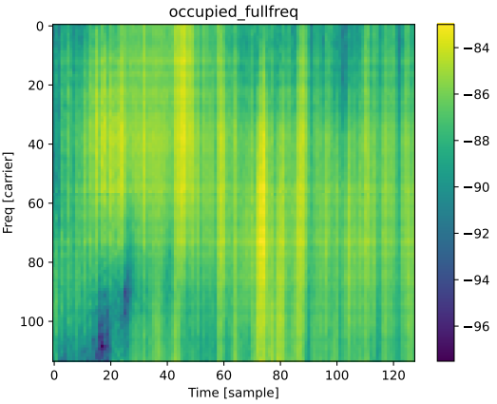
Wi-Fi CSI
Empty : Less variation across time, indicating minimal environmental interference
Fewer subcarriers are used, but a strong signal pattern is still visible
Occupied : More fluctuation in the color gradient, showing increased variation in subcarrier signal strength.
More variations across time remain but with a lower resolution than full frequency.

Slide 10
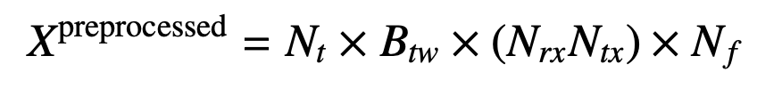
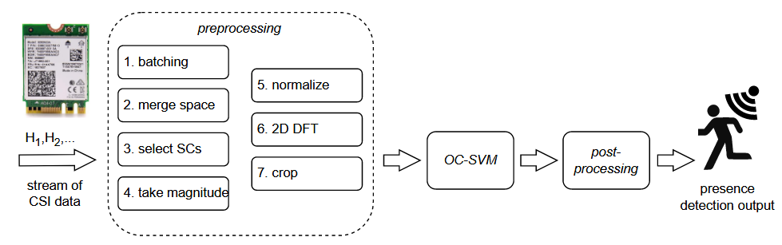
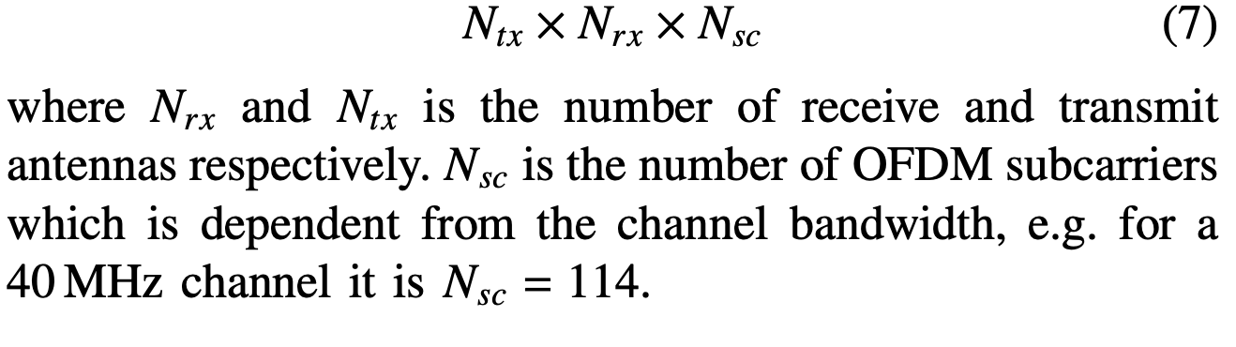
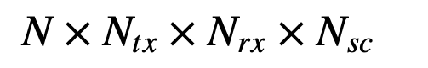
Methodology
Intel 9260 NIC
Preprocessed CSI= 490×14×4×15
compression of around 99.3%.
Capturing CSI= 63K*2*2*114
Notes:
The raw CSI data captured with a sample rate of S Hz must be preprocessed before it can be passed to ML algorithms. First, it group N CSI samples into Nt batches of size Bt, with each batch resembling a time window of Bt /S s. Then we reduce the dimensions by using only f subcarriers, leaving us with Nsc → Nf subcarriers. We select the f subcarriers evenly distributed across all Nsc subcarriers. This becomes possible as the subcarrier spacing in 802.11g/ac is 312.5 kHz which is much smaller than the coherence bandwidth in a typical indoor environment. Then we combine the dimensions of the receive (Nrx) and transmit (Ntx) antennas.
The received signal from different antennas are fed into different RF chains. These RF chains are not synchronized and thus the measured CSI will be distorted by the phase offsets between these RF chains [17]. This would require sanitation of the phase information which would complicate the algorithm. We therefore discard the phase information and instead use the magnitude of our CSI only.
Afterwards we normalize each grouped batch Bt in respect to the first CSI sample by element-wise division. we apply a 2D DFT to each grouped, normalized packet on the temporal and frequency domain to obtain the Fourier coefficients Xfft from which we take the magnitude (abs). Moreover, we shift the zero-frequency component to the center of the spectrum. The difference of the minimum and maximum of the Fourier coefficients can be too high to achieve good generalization. Therefore, we apply log10 (1 + x) to o
Finally, we cut off the left and right side of the matrix on the batch dimension Bt to obtain a further reduced data array Btw with only entries in its central dimension.

Slide 11
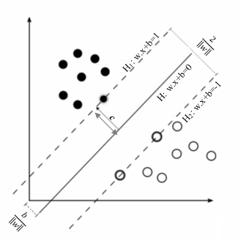
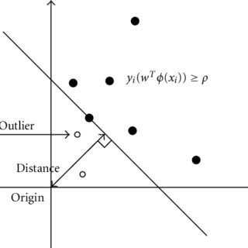
OC SVM
Regular SVM finds a maximum-margin hyperplane to separate two classes
OC-SVM finds a hyperplane that separates the given data from the origin
It learns from only one class and detects deviations from the learned pattern
Novelty Detection: Identifying new patterns in streaming data
The decision function is defined as
y_{i}(wTϕ(x_{i})) ≥ ρ
Determines whether a data point is normal or an outlier
Distance= ((wTϕ(x_{i})- ρ)/ || w ||
ϕ(xi​)( Feature Mapping) maps the input data into a higher-dimensional feature space using the RBF kernel- γ parameter
ρ is the threshold for decision-making, influenced by hyperparameter nu
Notes:
One-Class Support Vector Machine is a special variant of SVM that is primarily designed for outlier, anomaly, or novelty detection. The objective behind using one-class SVM is to identify instances that deviate significantly from the norm. It is an unsuperivised algorithm. It detect outliers or novelities within the dataset.
Th RBF kernel is used to fit a non-linear boundary around the dense region of the dataset separating the remaining points as outliers.
w is the weight normal (perpendicular) vector to the decision boundary.
The direction of w determines how the data is separated in the feature space.
The magnitude of w influences the margin size—the larger ∣∣w∣∣, the smaller the margin.
If distance is positive then normal, it distance is negative outlier.
RBF Kernel γ(gamma) – for boundary
Controls feature space mapping.
High → Complex model, sensitive to noise. Tight boundary
Low → Simpler model, smoother boundary.
Nu Parameter ( 0.05 means it allows 5 % outliers) -
Controls the fraction of outliers in the dataset or controls the sensitivity between False alarm and missed detections
High → More anomalies detected.
Low → Stricter boundary, fewer anomalies

Slide 12

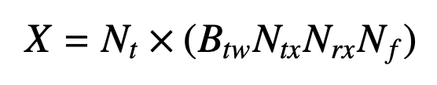
OC SVM
An unsupervised algorithm that learns decision function for novelty detection
Testing data from the unseen data from a room with presence and without presence
OC SVM treats human presence as a novelty
OC SVM simplifies the training process and only need to learn from empty rooms
Flatten the data dimensions of B_{tw}, (N_{rx}N_{tx}) and N_{f} into one dimension, features for the input
Number of sample * Features

Slide 13
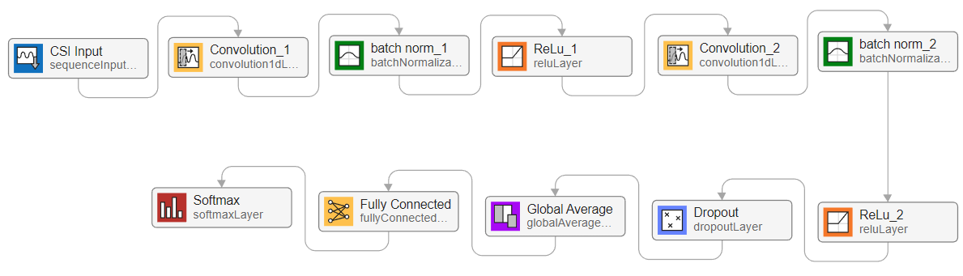



1D CNN
Weights : 5$×$840$×$16
Bias : 1$×$16
Offset : 16
Scale : 16
Weights : 3$×$1$6×32$
Bias : 1$×32$
Offset : 32
Scale : 32
CSI input with
840 dimensions
Convolution Layer 1
No of Filters: 16
Filter Size: 5
Stride: 1
Convolution Layer 2
No of Filters: 32
Filter Size: 3
Stride: 1
Empty
Occupied
Weights : 2$×32$
Bias : 2$×1$
Dropout: 20 %

Slide 14
Postprocessing
OC SVM could wrongly classify human absence when in reality the human is simply standing still
A completely static human has only a low effect on the CSI
To reduce misclassification, a post-processing step is applied using a majority vote over the last k predictions
Instead of relying on a single OC-SVM prediction, the system looks at the last k predictions and assigns the most frequent label
During transitions (human enters/leaves), false detections may occur
Time Step | 1 | 2 | 3 | 4 | 5 | 6 | 7 | 8 | 9 | 10
OC-SVM Output | 1 | 1 | 1 | -1 | -1 | -1 | -1 | 1 | 1 | 1
Post-Processed Output | - | - | - | 1 | 1 (false positive) | -1 | -1 | -1 (false negative) | 1 | 1

Slide 15
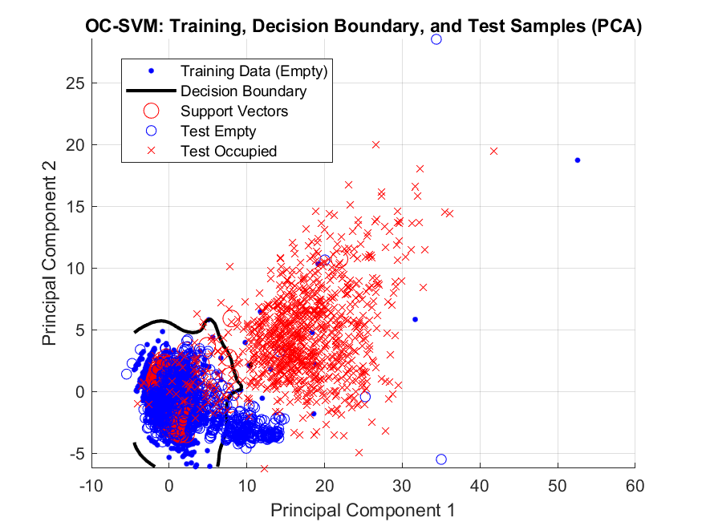
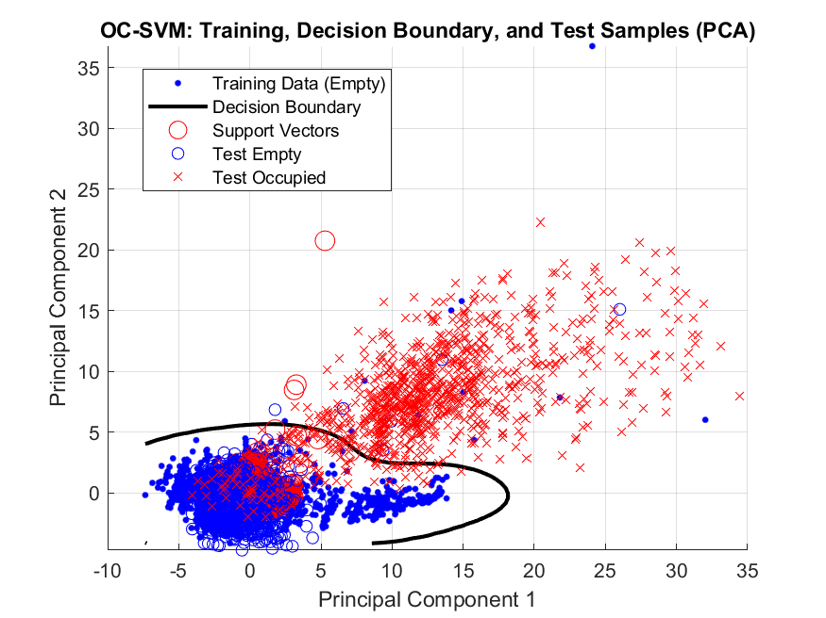
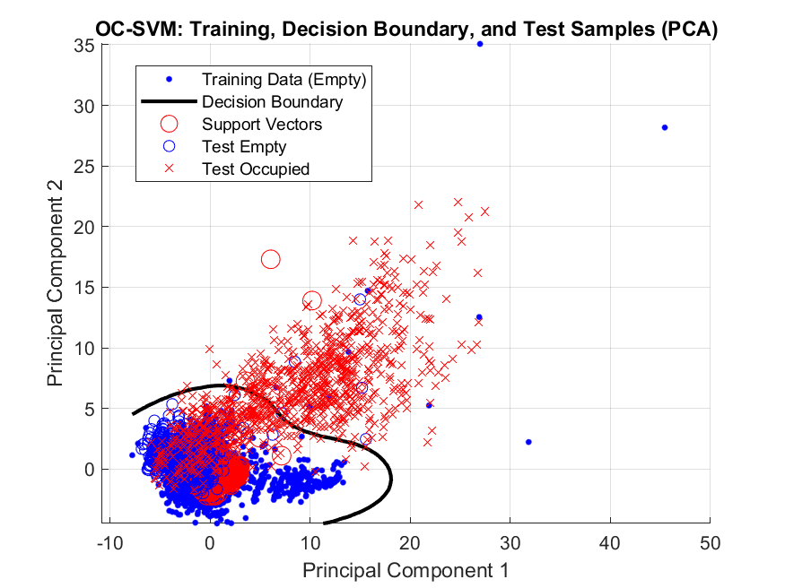
Result
Decision boundary and support vector for each scenario
Points inside the contour are empty and outside are outliers (occupied)
Train: Room A and Room B
Test: Room C
Train: Room B and Room C
Test: Room A
Train: Room C and Room A
Test: Room B

Slide 16
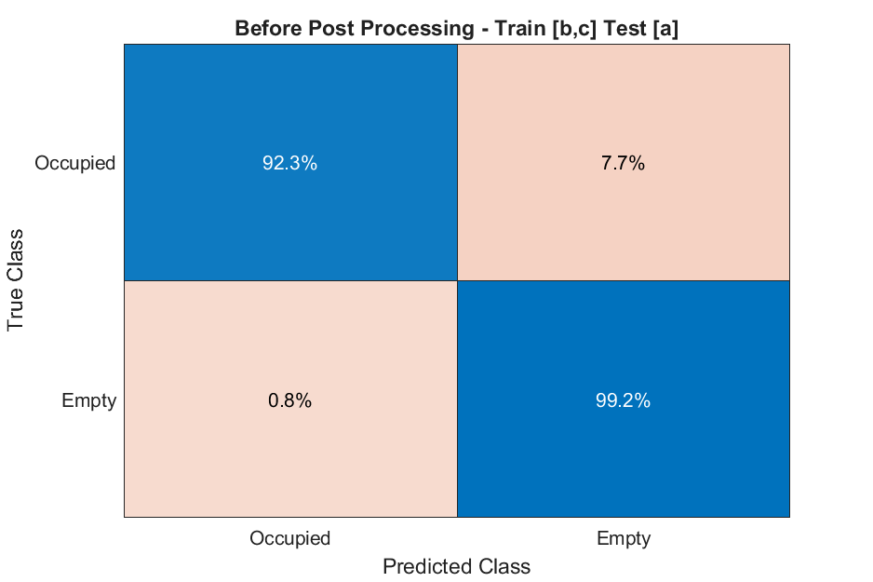
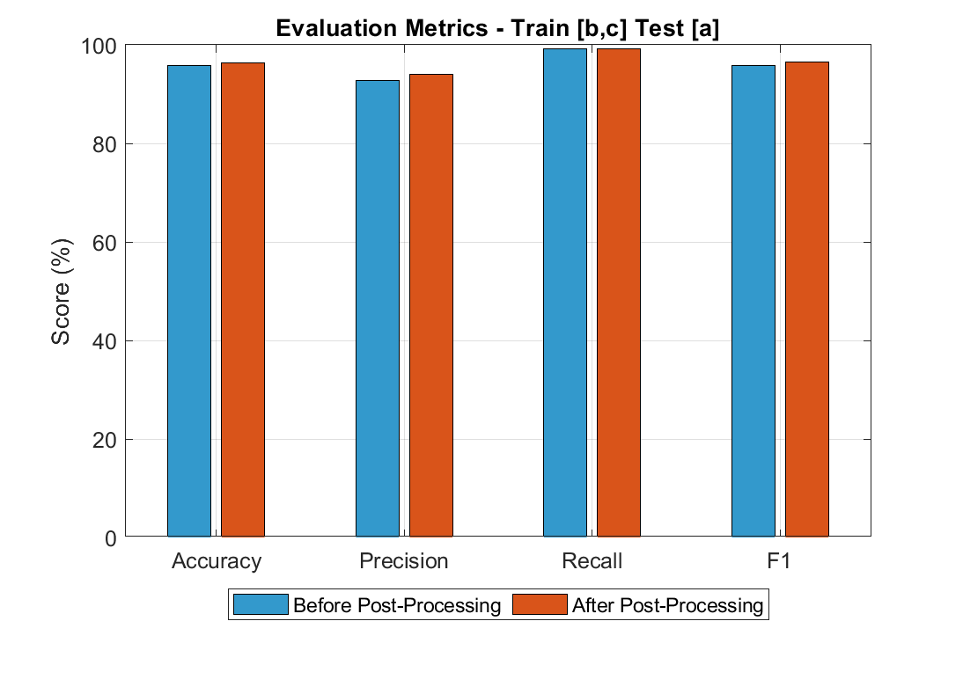
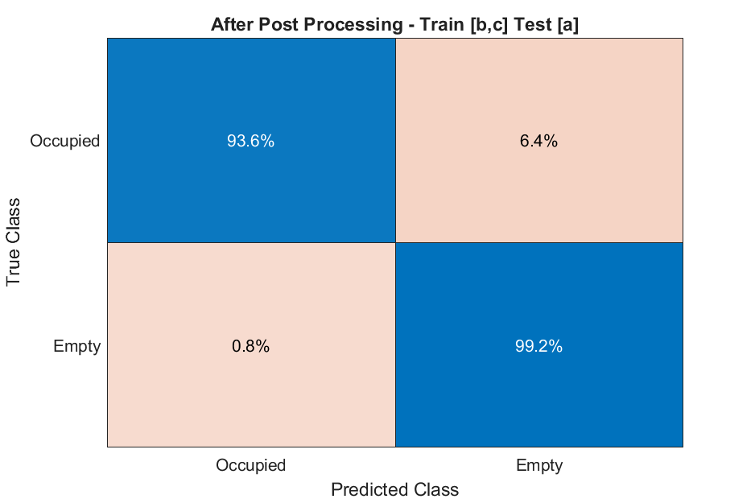
Result
OC-SVM Model Size (Support Vectors): 6575.62 KB
Before Post Processing Accuracy: 95.73%
Post-Processed Accuracy (k=5): 96.39%
Prediction Time (Total): 0.2096 seconds

Slide 17
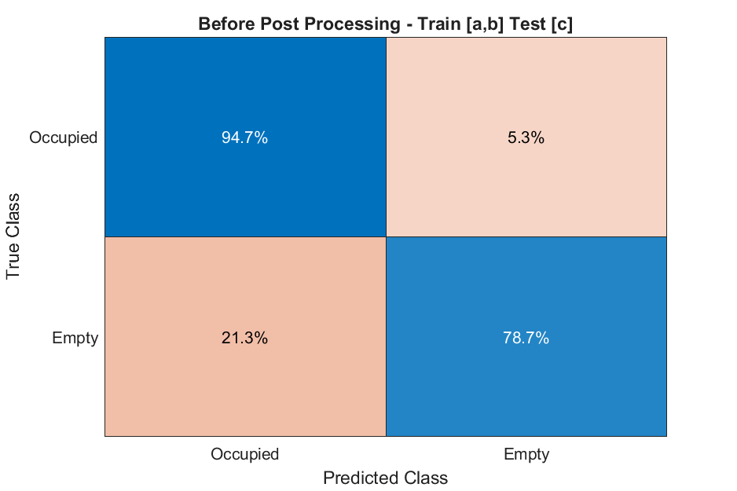
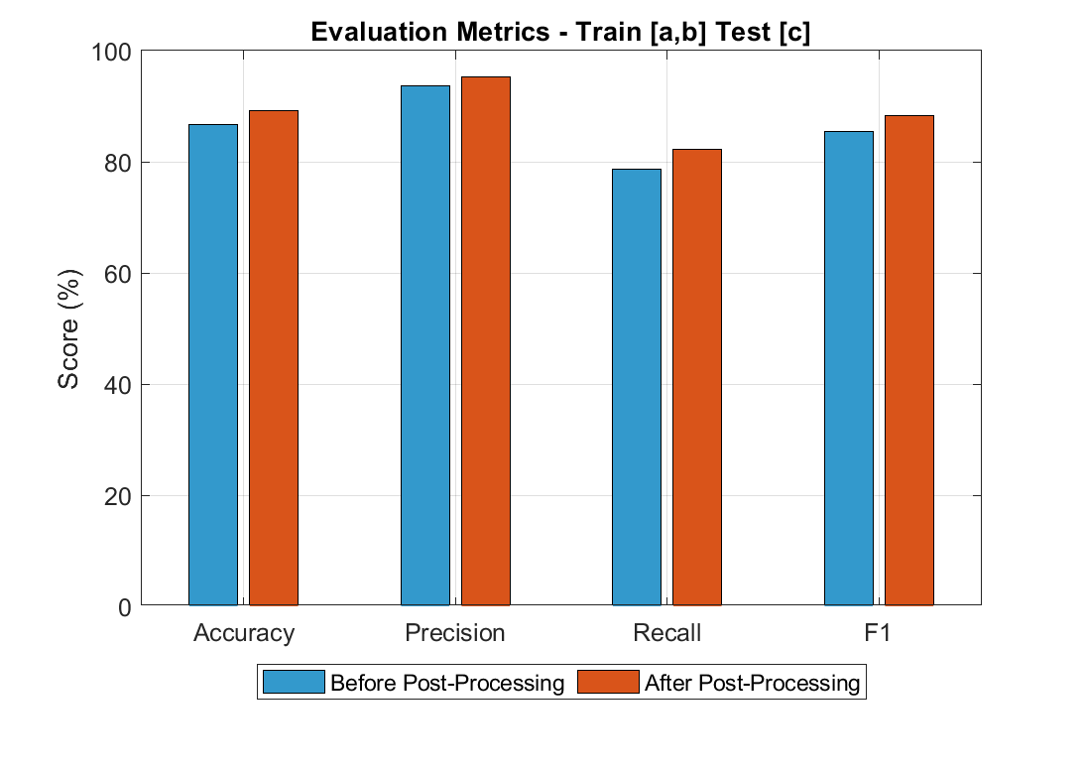
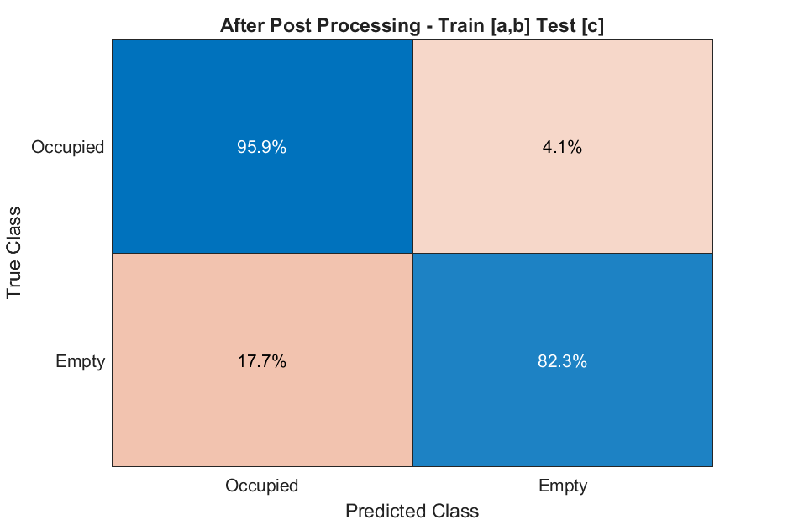
Result
OC-SVM Model Size (Support Vectors): 6555.94 KB
Before Post Processing Accuracy: 86.69%
Post-Processed Accuracy (k=5): 89.13%
Prediction Time (Total): 0.2285 seconds

Slide 18
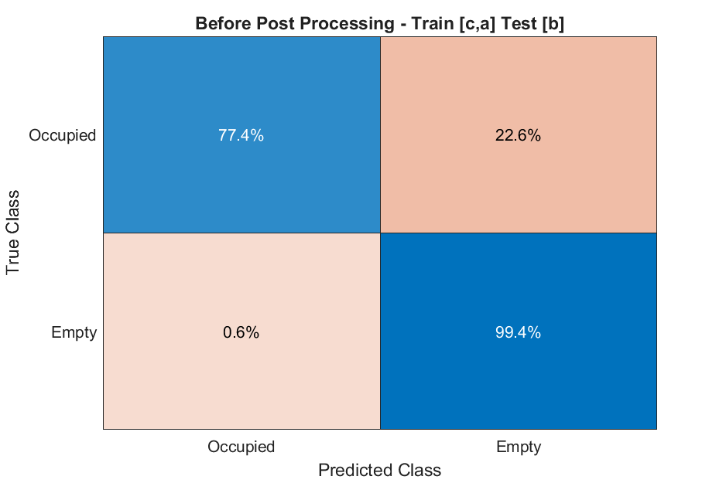
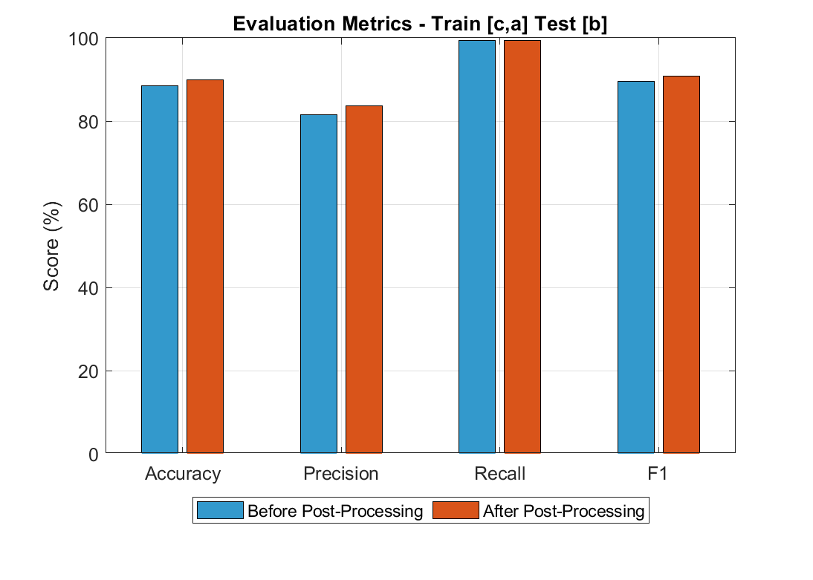

Result
OC-SVM Model Size (Support Vectors): 6575.62 KB
Before Post Processing Accuracy: 88.41%
Post-Processed Accuracy (k=5): 89.99%
Prediction Time (Total): 0.2018 seconds

Slide 19
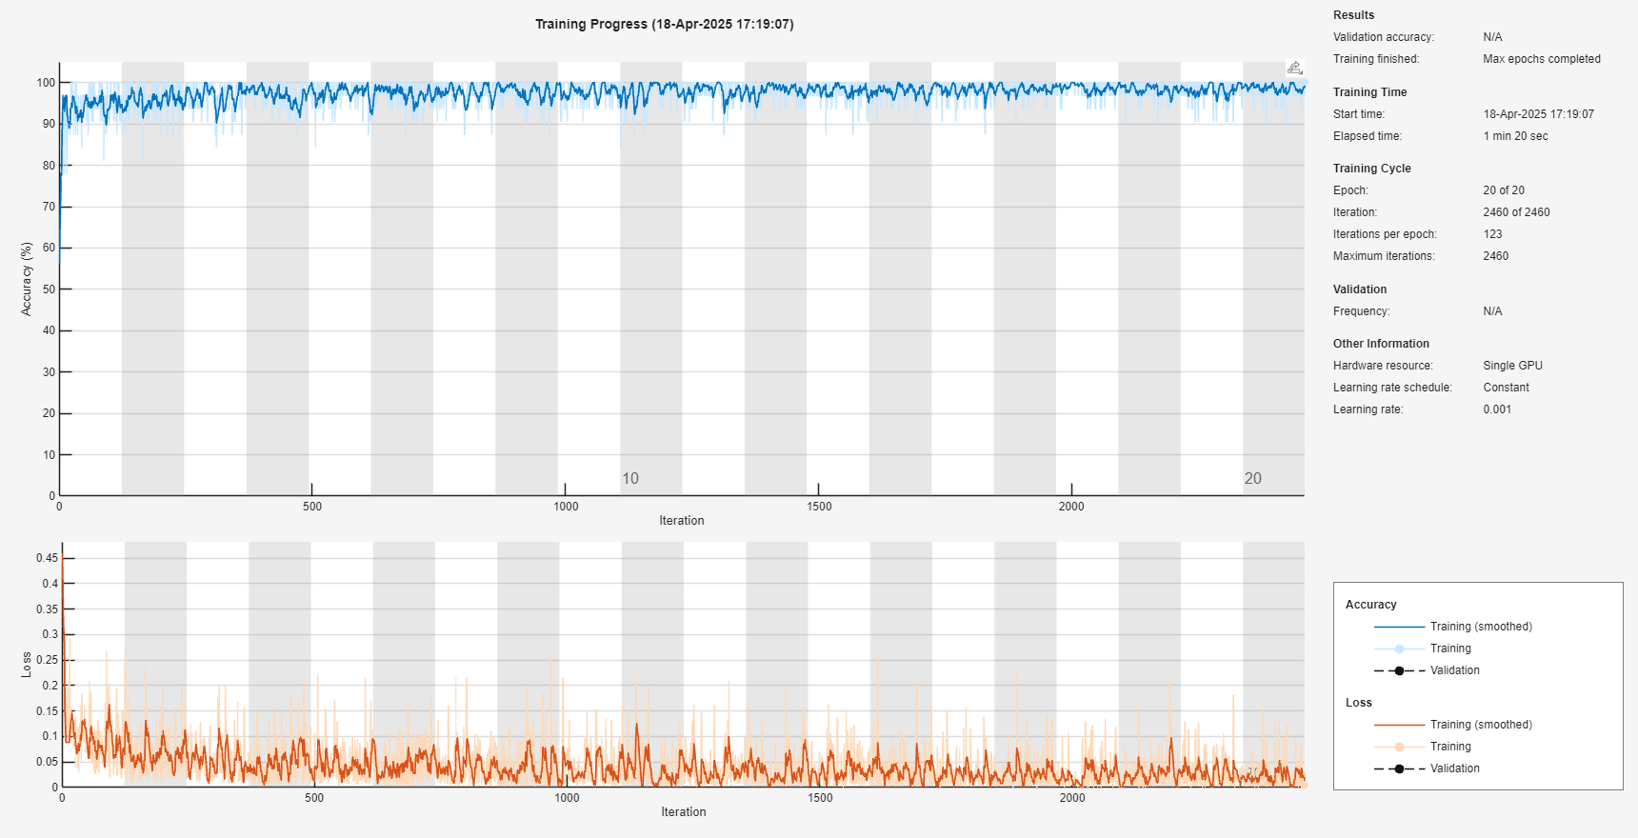
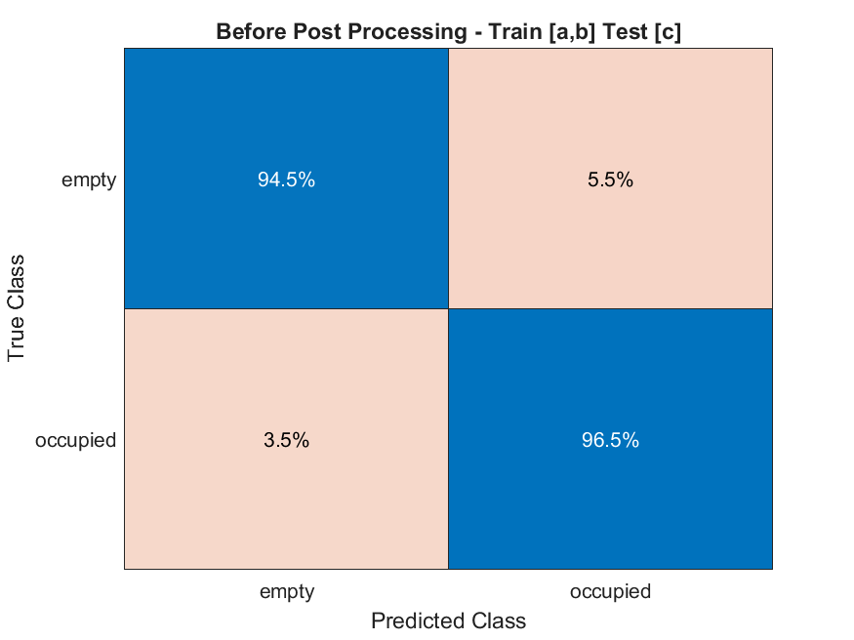
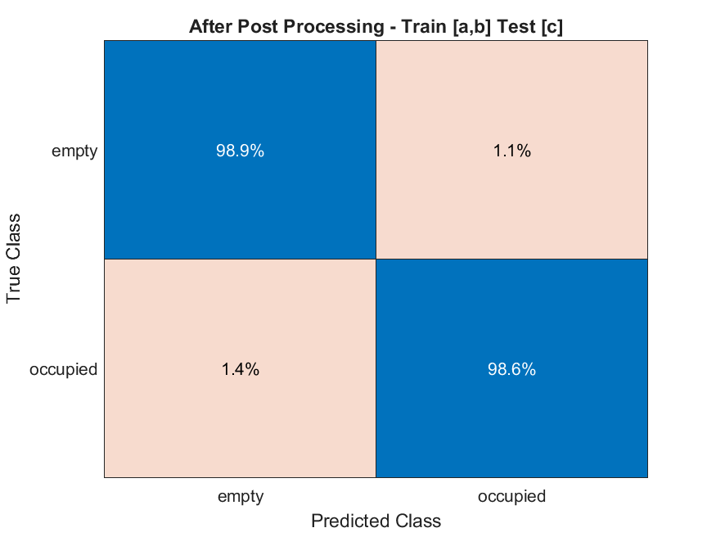
Result
Test Room: C
CNN Model Size: 268.95 KB
Before Post Processing Accuracy: 93.55%
Post-Processed Accuracy (k=5): 98.32%
Prediction Time (Total): 0.7123 seconds

Slide 20



Result
Train Rooms: B, C
Test Room: A
CNN Model Size: 268.95 KB
Before Post Processing Accuracy: 95.38%
Post-Processed Accuracy (k=5): 96.80%
Prediction Time (Total): 0.5519 seconds

Slide 21
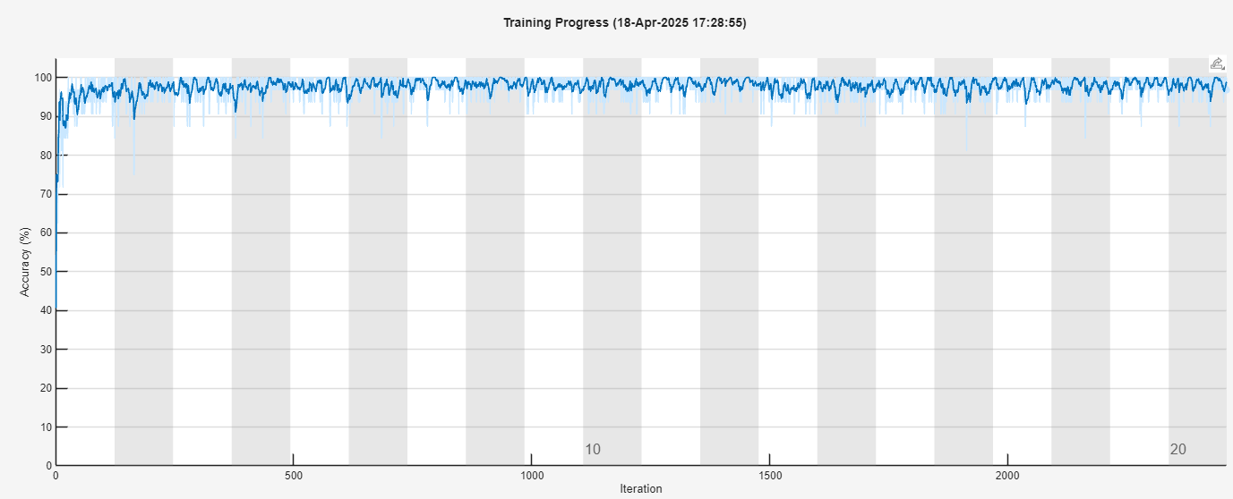


Result
Train Rooms: C, A
Test Room: B
CNN Model Size: 268.95 KB
Before Post Processing Accuracy: 93.19%
Post-Processed Accuracy (k=5): 97.92%
Prediction Time (Total): 0.5269 seconds

Slide 22
Result

Slide 23
Conclusion
OC SVM was used in the original paper by using all the rooms training data.
A low computational complexity device-free human presence detection method.
Using only CSI Magnitude for human presence detection
Generalization testing across unseen room.
1D CNN outperforms the OCSVM.
1D CNN model size is less than OC SVM model size due to high dimensional support vectors.

Slide 24
References
Zubow, Anatolij, Kim Petto, and Falko Dressler. “One-Class Support Vector Machine for WiFi-Based Device-Free Indoor Presence Detection,” n.d.
Wang, Jingjing, and Joongoo Park. “An Enhanced Indoor Positioning Algorithm Based on Fingerprint Using Fine-Grained CSI and RSSI Measurements of IEEE 802.11n WLAN.” Sensors 21, no. 8 (April 14, 2021): 2769. https://doi.org/10.3390/s21082769.

Slide 25
Thank you!

Slide 26
Additional Slides

Slide 27
